Slide 1
Atlas
Awake

Slide 2
Hell0!
I am Ranjith

Slide 3
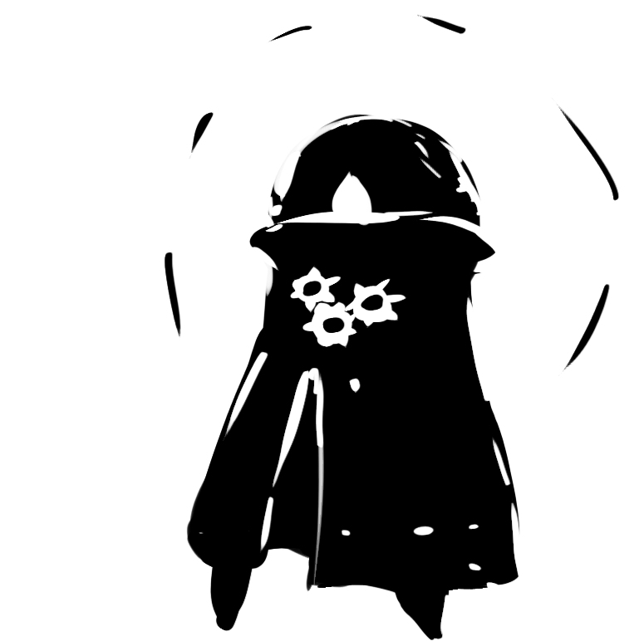
Hack and slash platformer
Master of time, Defender of the earth

Slide 4
Long story short
God made life on earth and left it with the protector of earth, he protects until he gets bored and takes a little nap, he wakes and humans did what they are really good at MESSING THINGS UP, The world is shit Figure out the way to fix it before god finds out

Slide 5
Overview
In "Atlas Awake", players take on the role of the powerful and ancient protector of the earth, Atlas. After being instructed by God to care for the planet and its inhabitants, Atlas falls into a deep slumber, only to awaken to find the world in ruins due to environmental devastation.
Equipped with the ability to manipulate time, Atlas must traverse six visually stunning and moody biomes, battling enemies and solving puzzles. Players must use their time control powers to overcome obstacles, uncover the cause of the destruction, and ultimately vanquish the source of the problem before God arrives to judge the world.
With intense combat, intricate level design, and a mind-bending narrative, "Atlas Awake" challenges players to save the world from its own demise by controlling time itself.

Slide 6
INNOVATION

Slide 7
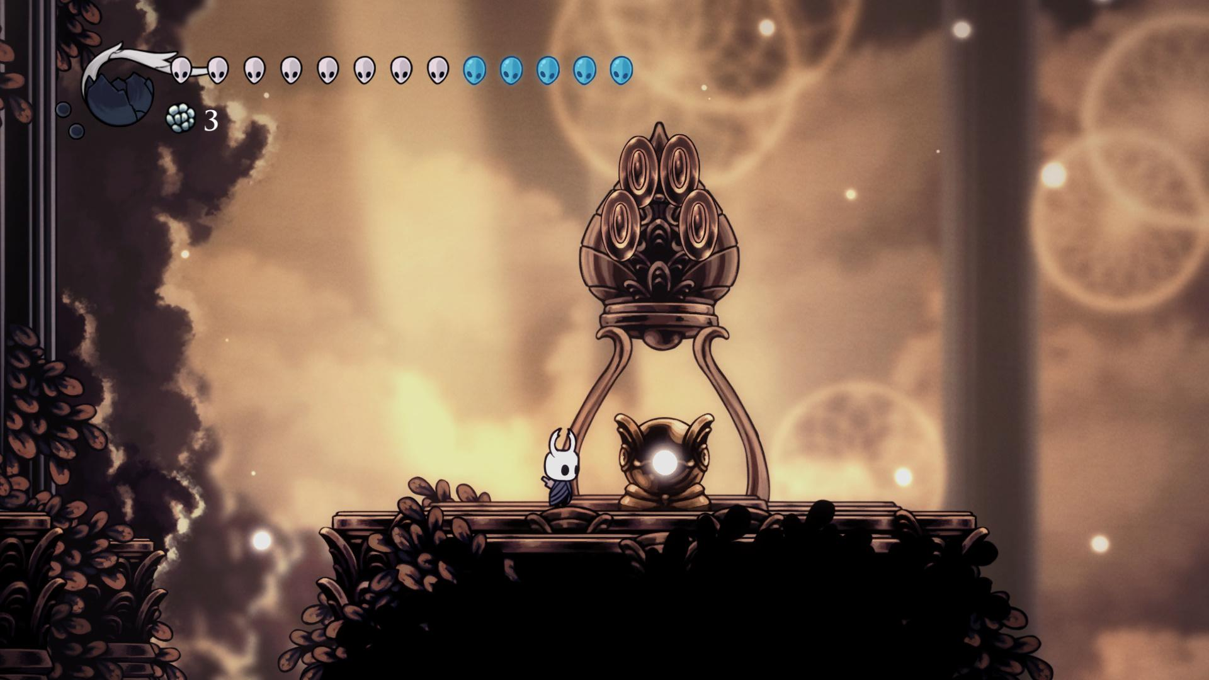
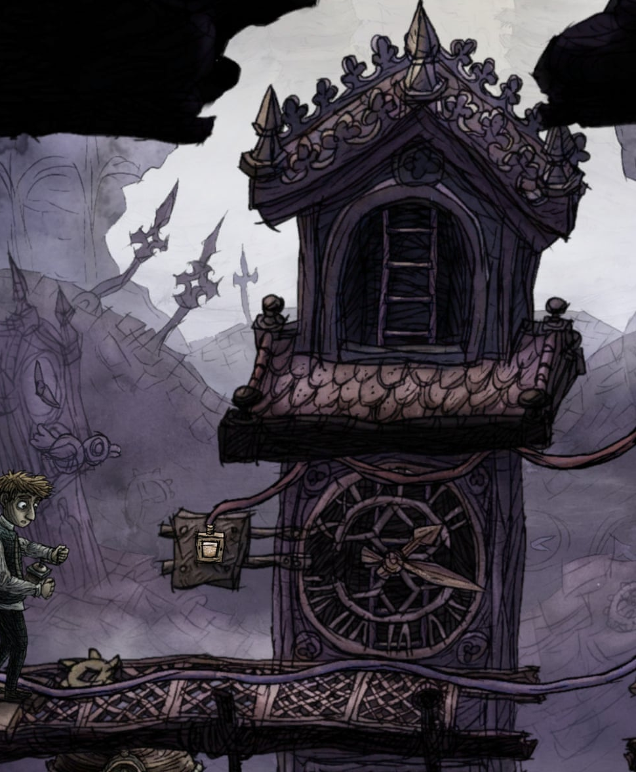
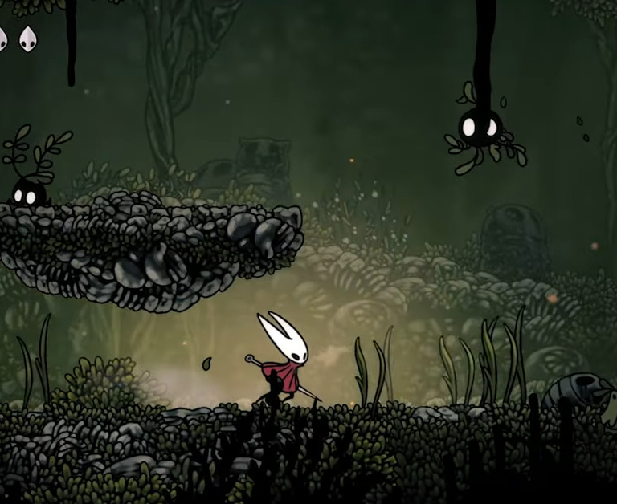
An Evocative Hand Crafted world
The world of Atlas awake is brought to life by vivid, moody detail to each biome and with frames animated by hand in a traditional 2D style.

Slide 8

Deep story and world design
The game features psychological plot twists and a narrative that constantly evolves based on the player's choices, along with numerous quests that impact progression and ultimately lead to different endings.

Slide 9

Mobile integrations
allowing players to have complete control over the character and fully immerse themselves in the game world using features like gyro and gesture controls.

Slide 10
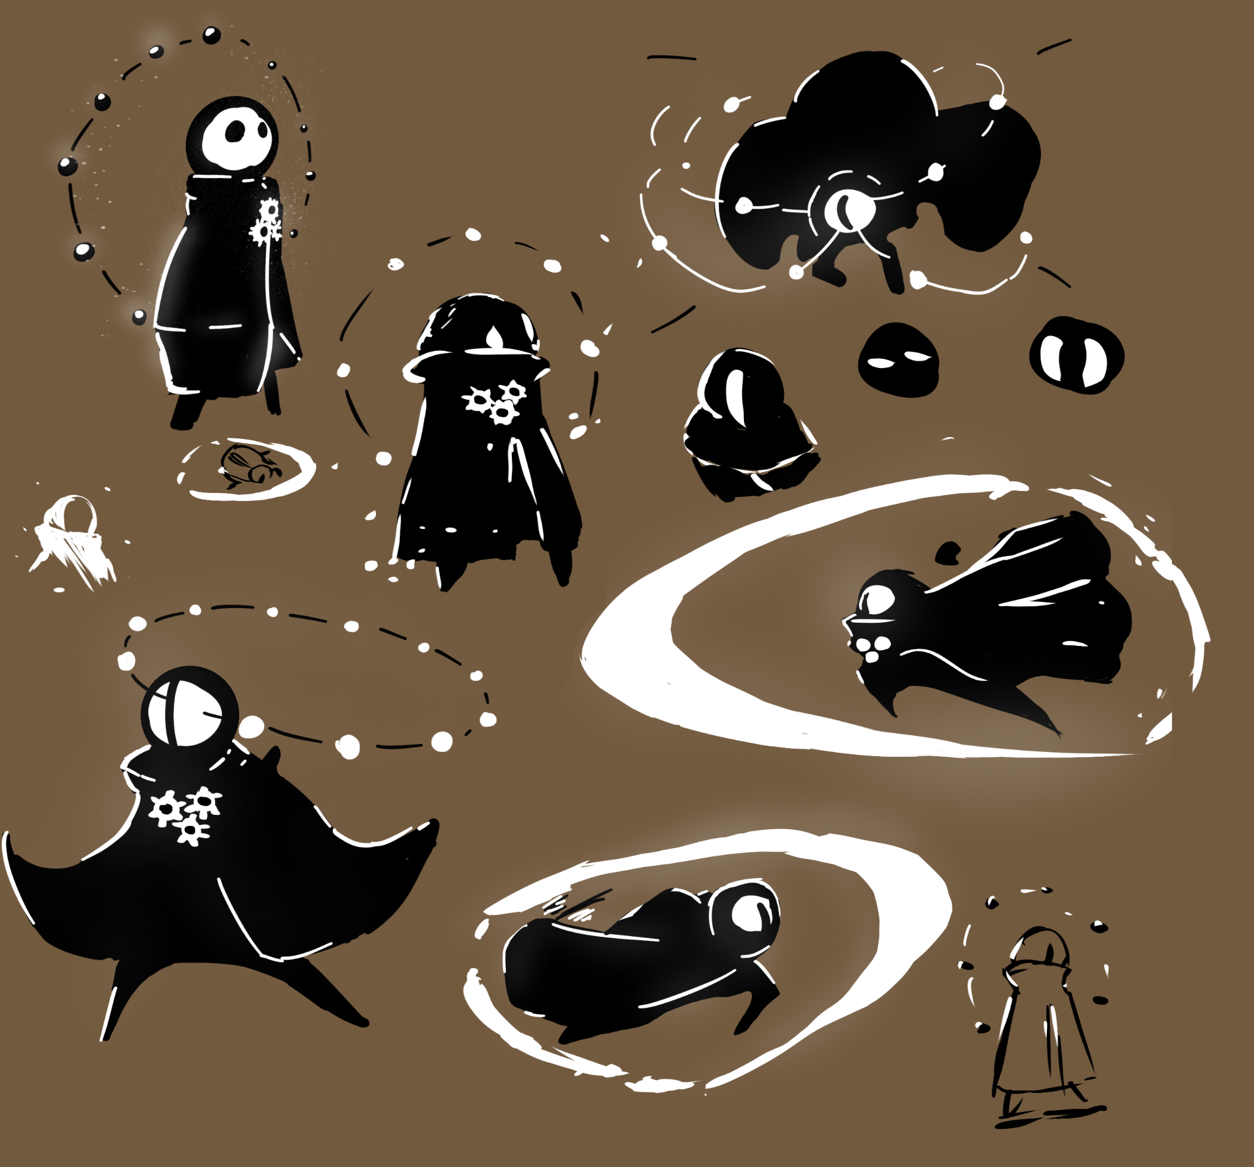
Character’s abilities
the game features a fast-paced combat system and easy-to-master movement mechanics, along with various abilities such as time manipulation, flight, and underwater swimming that make players feel incredibly powerful and god-like.

Slide 11
Unique Technical details

Slide 12
BackStory
GOD created the world and appointed Atlas and twelve spirits to maintain balance. They lived in the spirit realm , controlling time and monitoring the world. However,Due to Atlas’s absence humans grew greedy and built industries that polluted the earth, causing the spirits to go mad. Tchort, a powerful industrialist, ruled the world and dumped toxic waste, cut down trees, and polluted the air. His actions caused the spirits to deteriorate, and when he attempted to control the death spirit Yama he was possessed by the ruler of the void.

Slide 13
Gameplay plot
Act 1
Act 2
Act 3
The player have just awakened from a long slumber. He soon realize that the world has been destroyed by pollution, and the twelve spirits that they were tasked with protecting have gone mad.
The player's butler explains that the pollution caused the spirits to lose their balance, and he cannot even connect with the spirit world anymore. The player's first goal is to stop all living organisms on earth, except for those in the spirit realm, using their time powers.
Once this is done, the player meets up with their crew, including Hermes, who can open portals for them but only with energy points. Unfortunately, their points have been reduced due to their absence, and they need to vanquish lost entities to gain them back.
The player travels through a portal to Tchort's disposal site, an underground landfill area where they encounter Anu, a weak life spirit. She tells the player how humans have destroyed themselves through pollution and how Yama, the death spirit, is missing. An entity has opened a portal to attain power, preventing her from sensing Yama's presence. Anu also reveals that her life forces are trapped in other biomes.
The player brings Anu back to the hub and learns that they need to help the spirits regain their senses. To do so, they must master their biomes. Thoth, the knowledge guy, points the player in the direction of artifacts scattered by Horus, one of their warriors who has gone missing.
The player finds the artifacts and helps the spirits one by one.Their first stop is Tchort's power plant, where his corporation burns waste and fossil fuel, polluting the air. Enlil, the ozone spirit, has become enraged and started performing rituals to summon the player. After defeating her, the player brings her back to the hub.
Next, they visit Tiamat, the earth spirit, who loved the planet's geography. After seeing her home trashed, she becomes obsessed and starts collecting objects from the landfill, morphing them into herself. The player defeats her and gains access to the portal to Abzu, the water spirit. Abzu has always loved the ocean's life forms, but they have died due to Tchort's chemical dumping. She has developed a phobia of anything that approaches her. The player navigates through the ocean to reach her and learns that Tchort is responsible for everything. With the help of the other spirits, they defeat Abzu's minions and gain enough elemental energy to open the portal to the void.

Slide 14
Act 4
Act 5
Entering the void, the player finds that humans, possessed by souls in the realm, are the enemy. Yama, the death spirit, is now in Tchort, who has been possessed by the ruler of the void. The player must defeat Tchort and free Yama.
After freeing Yama, the player discovers that Tchort has been building a massive portal to the void to control all life and death. The player must stop Tchort's plans and defeat him once and for all, restoring balance to the world.
Quest 1 -
horus was one of our main warriors and was awake like the butler during our slumber he left us with all the items and artifacts around the world So with all those clues we can find and he will help us fight yama
Find Horus
Quest 2 -
Anu’s health depends fully on yama and since his connection was cut of we need to find life forces scattered throughout the map with the help Thoth to get her back and she will also help us fight yama
Revive Anu

Slide 15
Mechanics

Slide 16
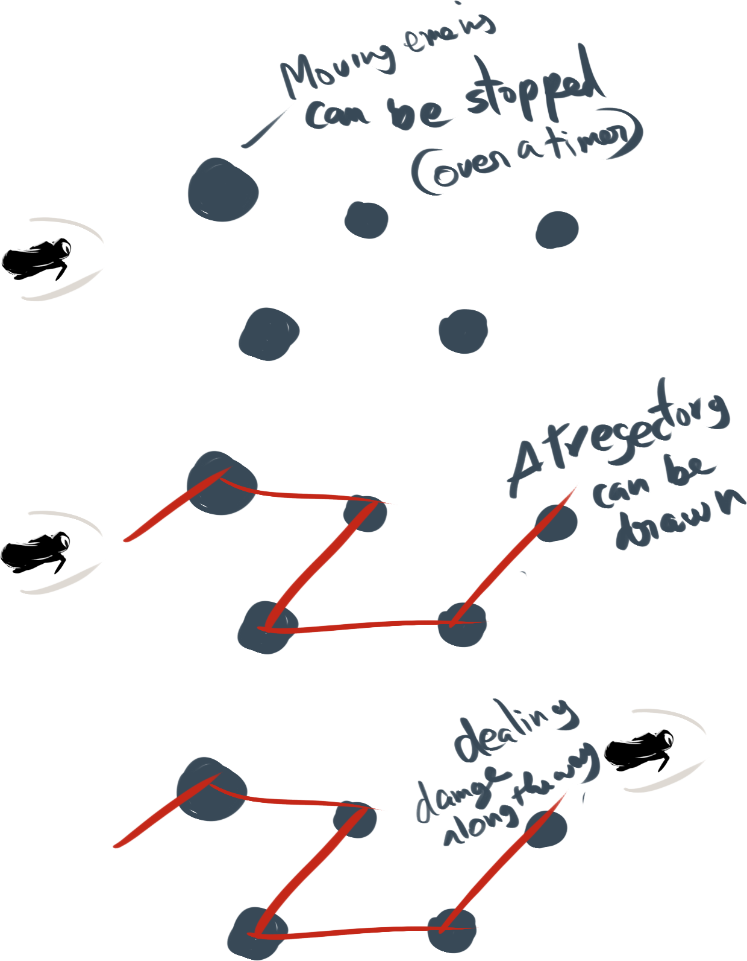

Default abilities
acQUIRED ABILITIES
Basic movements
Dashing
Jumping
Speeding time and stopping time
Manipulating rock
Underwater swimming - for the water biome
Double jump - for the air biome

Slide 17
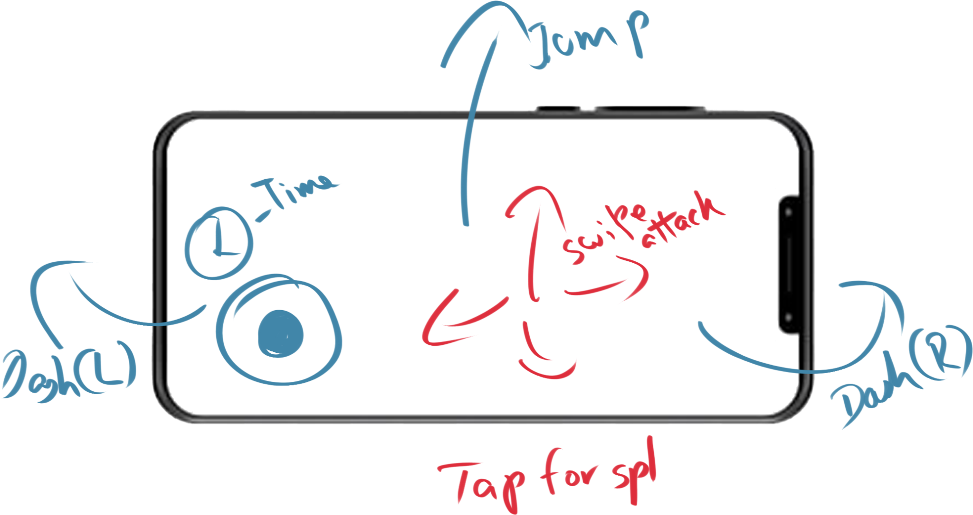
tECHNICAL DETAILS

Slide 18

MArketing

Slide 19
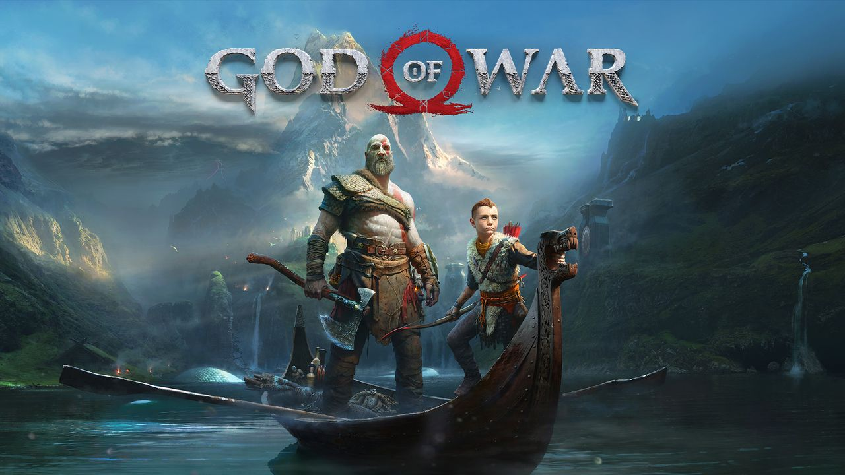
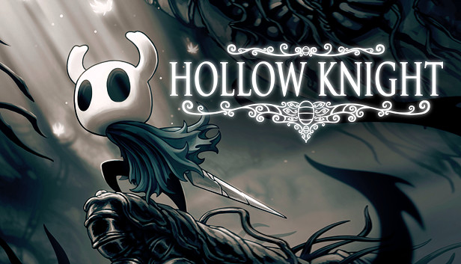
Comparison
God of war
Hollow knight
GENRE: 3d role playing
SALES: $189.7 million.
PLATFORM : PS/PC
DATA : 30 gb
Length : 20 hours
GENRE: 2d role playing
SALES: $2 million
PLATFORM: PS/PC
DATA : 1.5 GB
Length : 35 hours

Slide 20
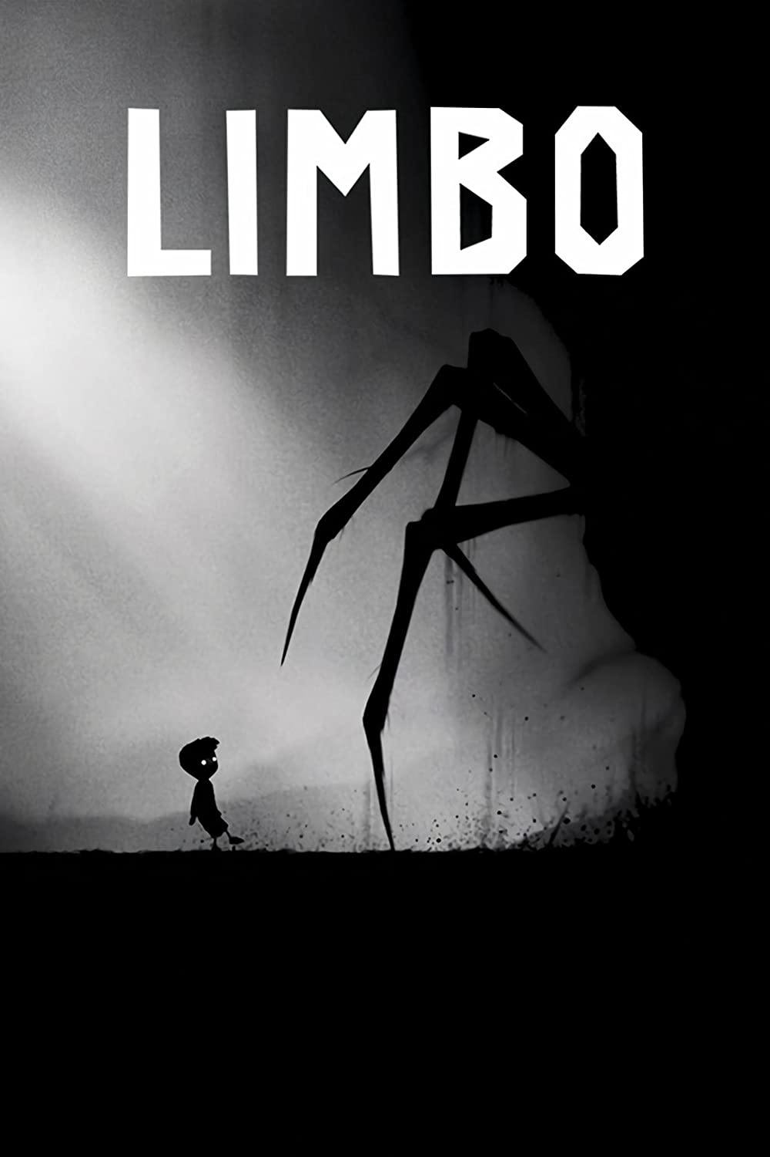
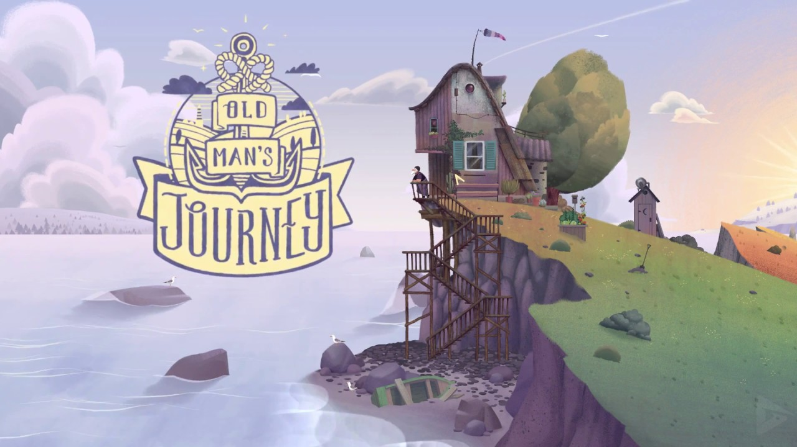
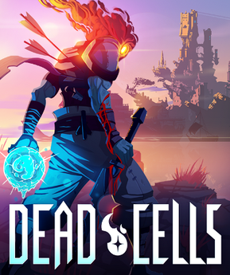
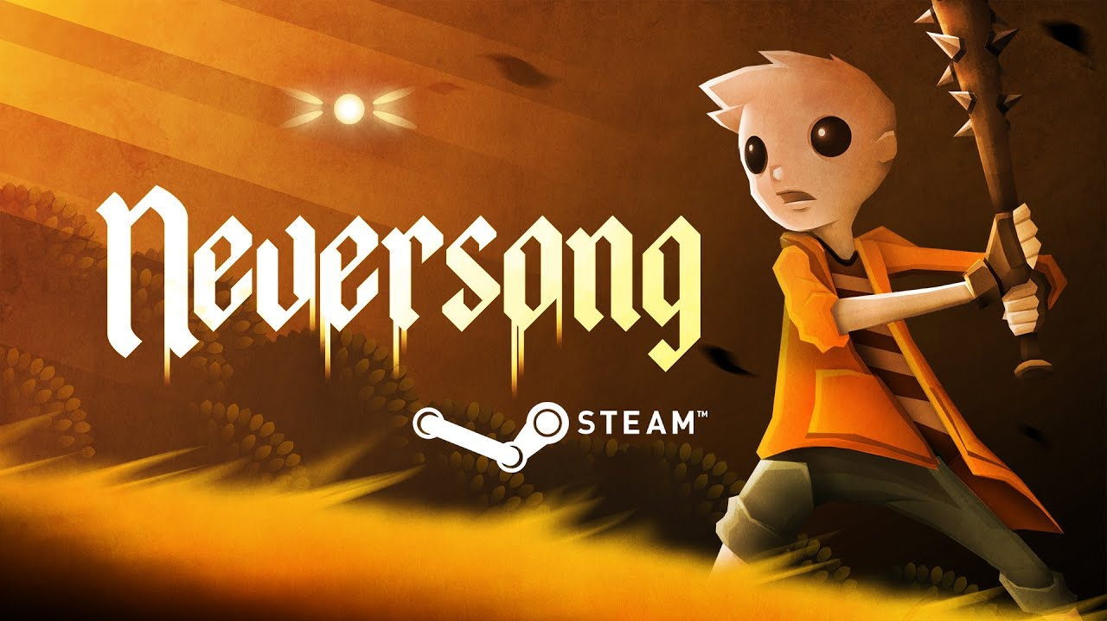
Similar games in the market

Slide 21

TArget audience

